Slide 1
Data experiment (sign_up & purchase events)
Aleksandar Popovic

Slide 2

Agenda
Overview of data
Timeline of events
Events by category
User Analysis
Conclusion

Slide 3
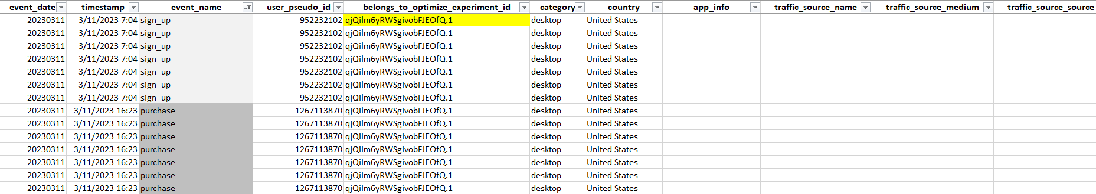
Raw Data
Goal: Increase sign_up & purchase events.
Two experiment groups:
Control Group ‘ExperimentID.0’
Alternative Group ‘ExperimentID.1’

Slide 4
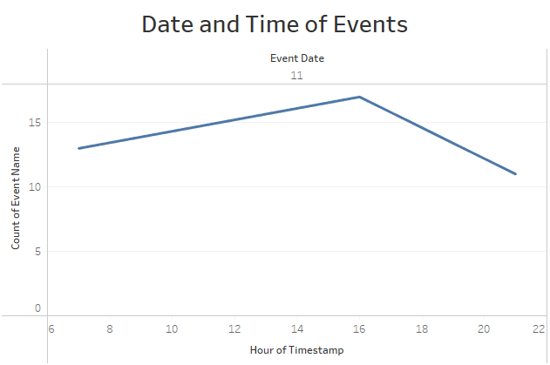
When did the events occur
Visual of date and time of any sign_up and purchase events that occurred in the dataset.
All happened on March 11th.
All belong to Alternative group.

Slide 5
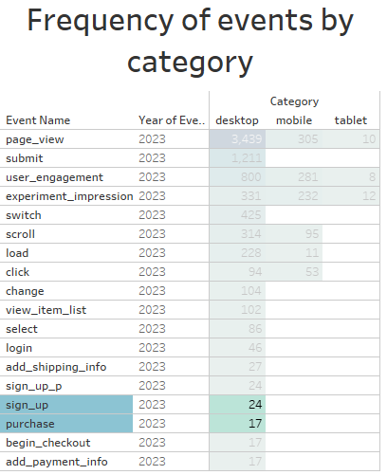
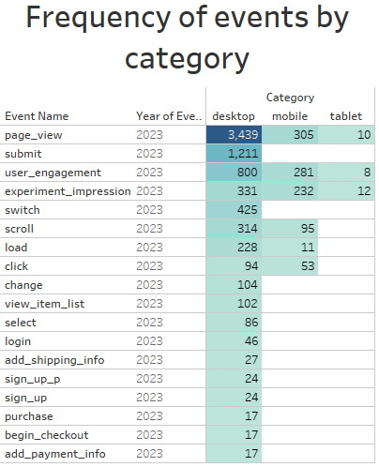
Events by Category

Slide 6
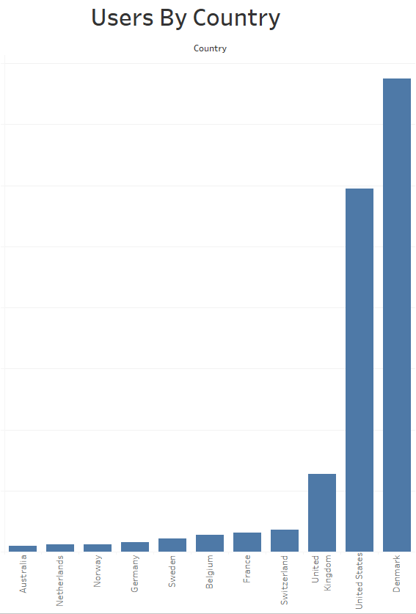
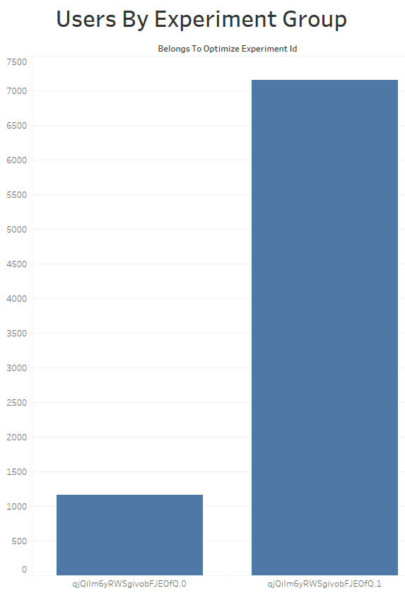
Users
Visual of users by country and experiment groups (includes all events)

Slide 7



Conclusion
Targeted events we’re triggered only using Desktop.
Users are from USA & UK.
Purchase event we’re triggered at 4pm, sign_up at 7am and 9pm. (March 11th)

Slide 8




Thank you
Aleksandar Popovic
apopovic997@gmail.com

